Slide 1

SENIOR YEAR

Slide 2
NEW COUNSELOR ASSIGNMENTS
COUNSELOR | STUDENT LAST NAMES | EMAIL
Academy Students (DEH, HSPSL, BMIT, VPA, CAFDM)
Mr. Sepulveda | A-D | ksepulveda@dadeschools.net
Ms. Collado | E- MARTINEZ, K | 339573@dadeschools.net
Ms. Pedroso | MARTINEZ, L- RI | bpedroso@dadeschools.net
Ms. Bergouignan | RJ-Z | mebergouignan@dadeschools.net
IB Students
Ms. Lezcano | A-K | nlezcano@dadeschools.net
Ms. Kurzner | L-Z | lkurzner@dadeschools.net
AOF Students
Ms. Lezcano | A-GOM | nlezcano@dadeschools.net
Ms. Kurzner | GON- N | lkurzner@dadeschools.net
Ms. Bergouignan | O-Z | mebergouignan@dadeschools.net
College Information
Ms. Sanz | ALL STUDENTS | ssanz@dadeschools.net

Slide 3
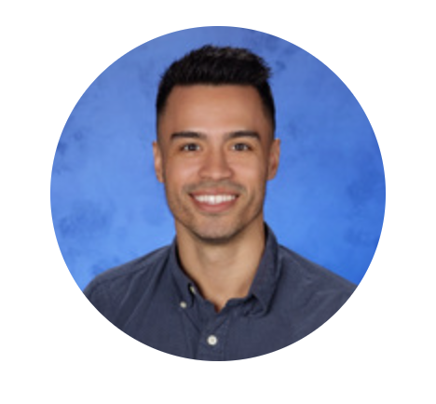
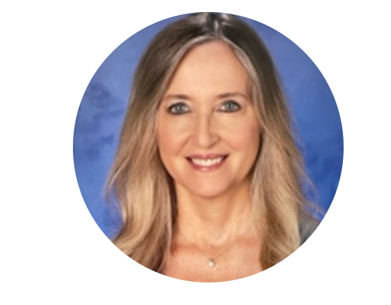
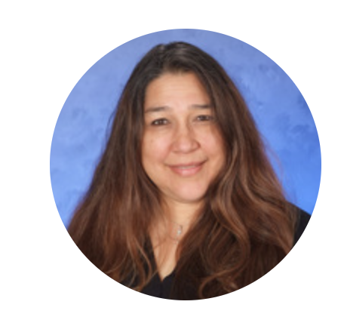
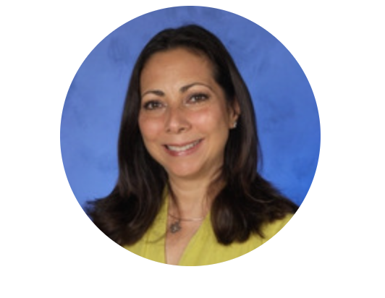

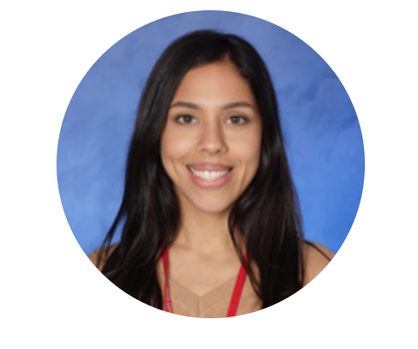
COUNSELORS
Mr. Sepulveda
Ms. Kurzner
Ms. Pedroso
Ms. Bergouignan
Ms. Lezcano
Ms. Collado

Slide 4
COUNSELOR ASSISTANCE
ACADEMIC
  Falling behind in classes
  Study skills
  Organization
GRADUATION
  Missing credits
  Adult Education Registration
ATTENDANCE
  Extended illness
  Family emergency
COLLEGE AND CAREER PLANNING
  Admissions requirements
  Career exploration
PERSONAL
  Anxiety
  Depression
  Family Issues
  Relationships
MENTAL HEALTH
  Outside agencies

Slide 5
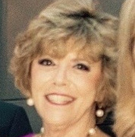
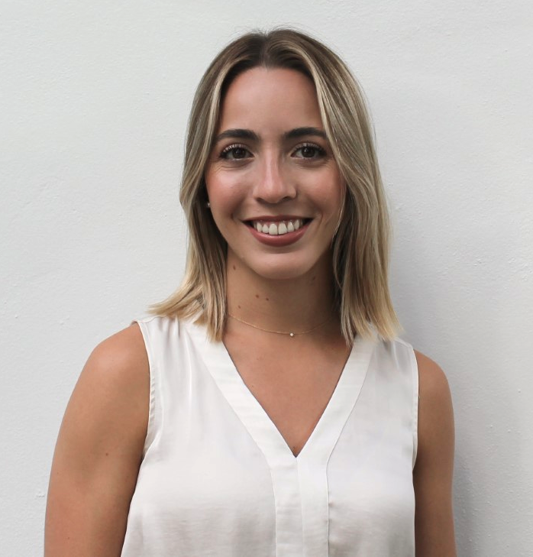
STUDENT SERVICES
MRS. COSGROVE
GRADUATION COUNSELOR
francosgrove@dadeschools.net
Ensuring students are on track to graduate
Testing, credits, GPA
MS. SANZ
CAP ADVISOR
ssanz@dadeschools.net
College information
Test and application fee waivers
Scholarships

Slide 6
MENTAL
HEALTH SUPPORT
ROOM 3103
MONDAY-FRIDAY
8:00 am- 1:00 pm
Social Worker
Mental Health Professional

Slide 7
GRADUATION REQUIREMENTS
SUBJECT | CREDITS
ENGLISH/LANGUAGE ARTS | 4: ELA 1, 2, 3, 4
MATHEMATICS | 4: *Must include Algebra 1 and Geometry
SCIENCE | 3: *Must include Biology 1 and two of which must have a lab
SOCIAL STUDIES | 3: World History, U.S History, U.S Government, and Economics with Financial Literacy
FINE AND PERFORMING ARTS, SPEECH AND DEBATE, OR PRACTICAL ARTS | 1: Eligible courses are in the Florida Course Code Directory
PHYSICAL EDUCATION | 1: To include the integration of health
ELECTIVES | 8

Slide 8
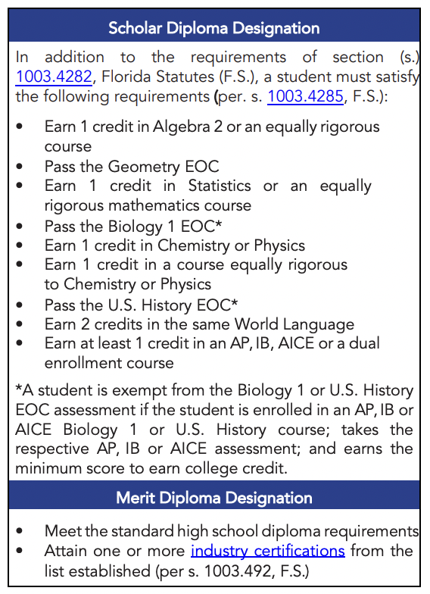

Slide 9
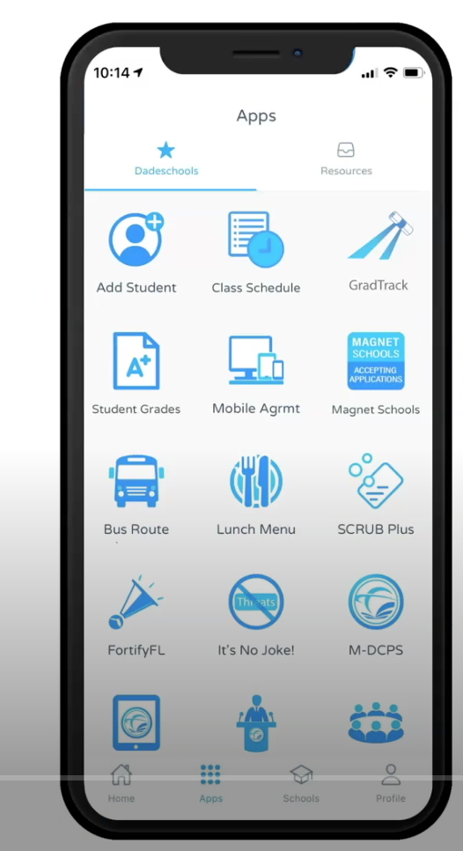
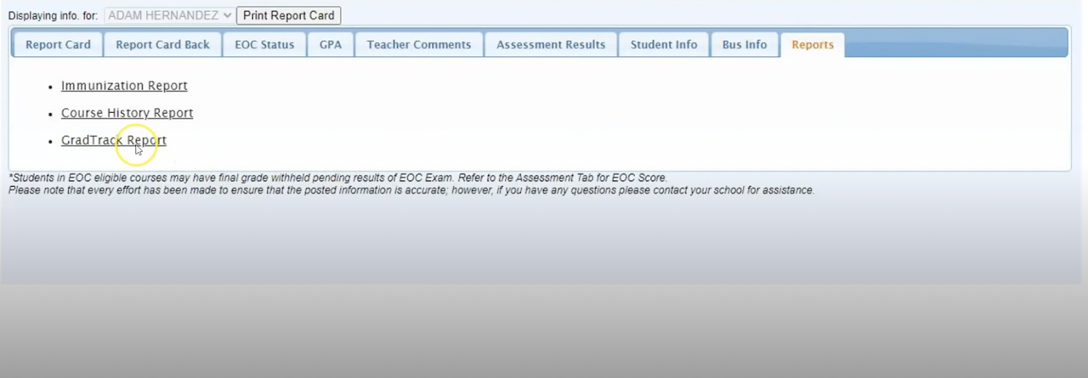
GRAD TRACK
Check your own requirements and progress for graduation
Information found on Grad Track:
  GPA, community service hours, summary of graduation requirements and how much they have completed
Access Grad Track through dadeschools app or on the student portal

Slide 10

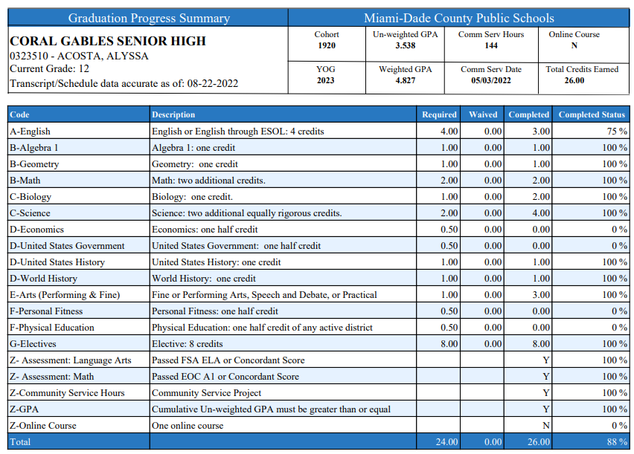
GRAD TRACK

Slide 11

CAP COMMUNICATIONS
Email: ssanz@dadeschools.net
Instagram: @Gables_CAP
MS Teams: Class of 2025
CAVSCONNECT.COM
CAP CORNER- SENIORS

Slide 12
UPCOMING EVENTS
SENIOR PARENT NIGHT:
  Wednesday, September 4th at 6:30 pm on Zoom
BRIGHT FUTURES:
  Application opens October 1st
FAFSA:
  *Application opens October 1st
COLLEGE FAIR:
  Monday, October 14th

Slide 13
WHAT ARE COLLEGES LOOKING AT?
IMPORTANT FACTORS:
Strength of curriculum (IB, AP, Honors)
Grade Point Average (GPA) and class rank (percentile)
College Entrance Examination Scores (ACT or SAT)
Activities student is involved in
IF THE COLLEGE REQUIRES THEM:
Essays
Recommendation Letters (teacher and counselor)
Resume (leadership, community service, extracurricular, talents, etc.)
Interviews

Slide 14
PICKING A COLLEGE OR UNIVERSITY
FACTORS TO CONSIDER:
Four-year, two-year, or vocational?
Location: close to home or far away? City life or college town?
Size: Under 3,000 students or over 30,000 students?
Coed or single sex?
Private or public institutions?
What programs are offered?
What sports or extracurricular activities are available?
Cost? Do not exclude any choices because of high cost (Expensive schools often offer more aid) ALWAYS CHECK THE NET PRICE CALCULATOR

Slide 15
YOUR COLLEGE LIST
AT LEAST 2 REACH SCHOOLS
AT LEAST 4 MATCH SCHOOLS
AT LEAST 2 REAL SAFETY SCHOOLS
RESEARCH THE COLLEGE’S ADMISSION DATA ON SCOIR OR LOOK AT THE COLLEGE’S WEBSITE FOR THE COMMON DATA SET:
most important facts and figures about a college that allows you to easily look up certain pieces of information, helps you compare colleges, and even provides demographic breakdowns of admissions and enrollment statistics

Slide 16
POST-SECONDARY EDUCATION
COLLEGE OR UNIVERSITY (FIU, Harvard, Pomona College)
COMMUNITY COLLEGE (Miami Dade College, Santa Fe)
VOCATIONAL/TECHNICAL (Robert Morgan, Lindsay Hopkins
MILITARY (Army, Navy, Marines)

Slide 17
POST SECONDARY EDUCATION
COMMUNITY COLLEGE: Better financially, MDC Honors
VOCATIONAL/TECHNICAL: quick path into the work force
MILITARY: scholarship opportunities

Slide 18
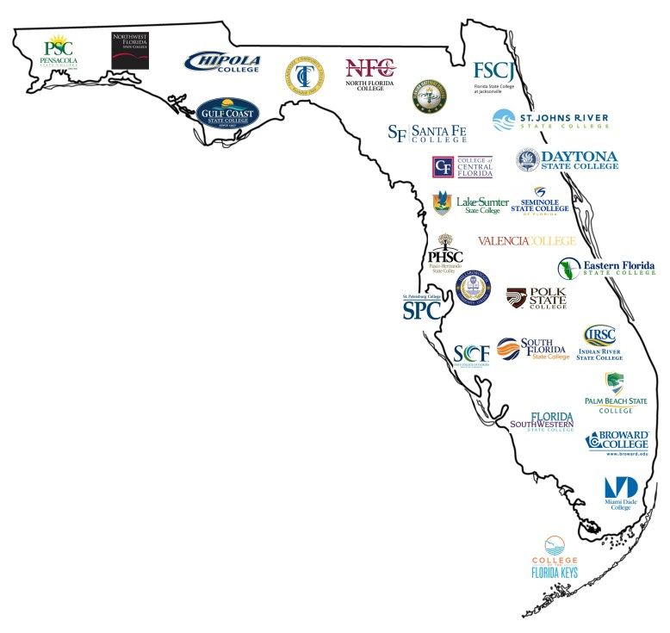

COMMUNITY COLLEGES
AND STATE UNIVERISTIES
Programs of 6 months to full Bachelor’s degrees
OPEN ADMISSIONS: anyone with a high school diploma or GED is admitted.
Vast selection of programs including Graphic Design, Music Production & Management, Fire Science Technology, Nursing and much more.
Programs to consider:
  MDC Honors
  MDC Pathway Program

Slide 19
COLLEGE ENTRANCE EXAMS
ACT
ACT scores range from 1 to 36.
English
Math
Science
Reading
SAT
SAT scores range from 400 to 1600.
Reading/Writing
Math

Slide 20
UPCOMING EXAM DATES
SAT
ACT
REGISTER AT SAT.SUITE.COLLEGEBOARD.ORG
REGISTER AT MYACT.ORG
REGISTER AT MYACT.ORG
EXAM DATE | REGISTRATION DEADLINE
August 24th | August 9th / 13th
October 5th | September 20th / 24th
November 2nd | October 18th /22nd
December 7th | November 22nd /26th
March 8th | February 21st / 25th
May 3rd | April 18th / 22nd
June 7th | May 22nd / 27th
EXAM DATE | REGISTRATION DEADLINE
September 14th | August 9th / 25th
October 26th | September 20th /7th
December 14th | November 8th / 22nd
February 8th | January 3rd / 20th
*Blue: last exam for UF deadlines
*Garnet: last exam for FSU deadlines

Slide 21
CLT INFO
REGISTER AT CLTEXAM.COM
Only valid for FL public universities (& a few others, check their website for the full list)
2 hours, 3 sections
  Verbal reasoning, grammar & writing, quantitative reasoning (math)
$69 (or apply for discount code on their website)
Some students say it is easier that SAT/ACT
You can sign up to take the exams at home
Results within 3 weeks

Slide 22
FEE WAIVERS
You must complete this form: incomesurvey.dadeschools.net
If you qualify for free or reduced lunch, you may qualify for testing and application fee waivers.
  4 ACT Waivers (4 different codes)
  2 SAT Waivers (1 code)
  Unlimited Scoir Application Fee Waivers
TO REQUEST AN ACT/SAT FEE WAIVER: see me in room 6111 or send me an email at ssanz@dadeschools.net
Scoir fee waivers can be requested under My Colleges- Application Documents
CLT waivers must be requested by the student on their website

Slide 23
SCOIR FEE WAIVERS
How to request an application fee waiver on Scoir
After I sign your waiver, save it to your computer
No limit on how many times you can use it
Some schools want the proof, others don’t. YOU NEED TO CHECK YOUR APPLICATION STATUS CHECK TO CONFIRM.
How to apply with a fee waiver on Common App

Slide 24
APPLYING FOR
ADMISSION
APPLICATION: required everywhere
TRANSCRIPT
APPLICATION FEE: (fee waiver(s) can be used, see me for more info.)
SAT/ACT SCORES: required or test optional
COPY OF OTHER REQUIRED DOCUMENTATION: (if applicable)

Slide 25
TYPES OF APPLICATIONS
EARLY DECISION: binding, regardless of financial aid status. You can only apply to only one ED school and must sign a contract, along with your parents & myself.
EARLY ACTION: nonbinding. Students can apply to multiple schools as EA. Apply early (October-November) and receive notice by December.
REGULAR DECISION: varies per college/university. most deadlines are around January and decisions are made by mid-March-April.​
ROLLING ADMISSION: accepts students as applications come in, and until they run out of spots, so apply early!​

Slide 26
WHERE DO I START?
Sign up for the SAT/ACT if you still need to do so.
Finish researching colleges and make your list/excel spreadsheet. Organize it by deadline!
Mark those schools as applying on Scoir.
Involve your family and look at the cost of attendance to these schools.
Go to the Undergraduate Admissions websites of each of your colleges. Create an account on their application site or Common App.
SAVE THE USERNAMES AND PASSWORDS IN A SAFE PLACE!

Slide 27
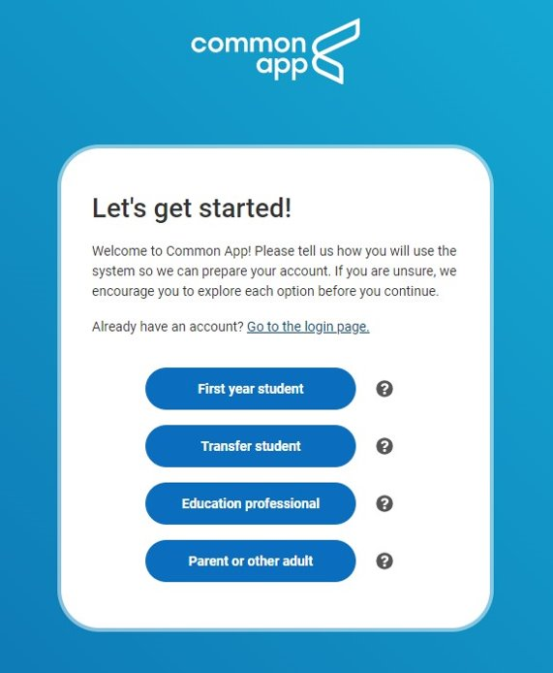
WHERE DO I APPLY?
INSTITUTIONAL APPLICATION: college admissions application provided by the specific school (or group of schools) that you are applying to. You can find this on the school’s admissions website.
COMMON APPLICATION: one of the most popular college admission applications. Appy to multiple schools using one application. ​
  Create an account at commonapp.org

Slide 28
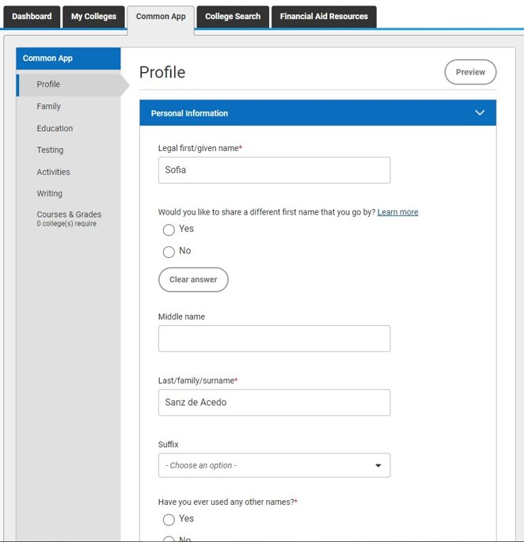
THE COMMON APP
DASHBOARD: summary of your applications​.
MY COLLEGES: your college applications. Every school may have different questions, supplements, or other requirements. This is where you will find that. You can submit different colleges at different times.​
COMMON APP: general information that every school will require. You can edit this at any time.

Slide 29
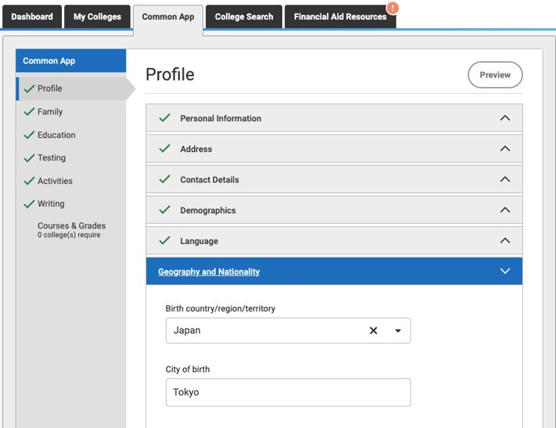
THE COMMON APP
PROFILE SECTION:
Each part of the common app profile is up-front and easy. ​
Not all of it is required as you will see by the red asterisk.
If you feel uncomfortable answering something that is optional, you may omit it.

Slide 30
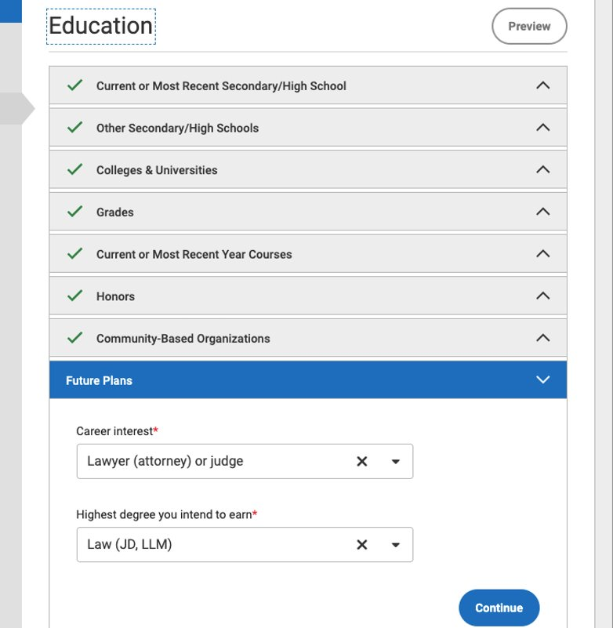
THE COMMON APP
EDUCATION SECTION:
Answer questions about the school you are in currently (Gables), any other schools you may have attended including colleges (dual enrollment), senior year courses, any honors you may have received, and your career or education plans.

Slide 31
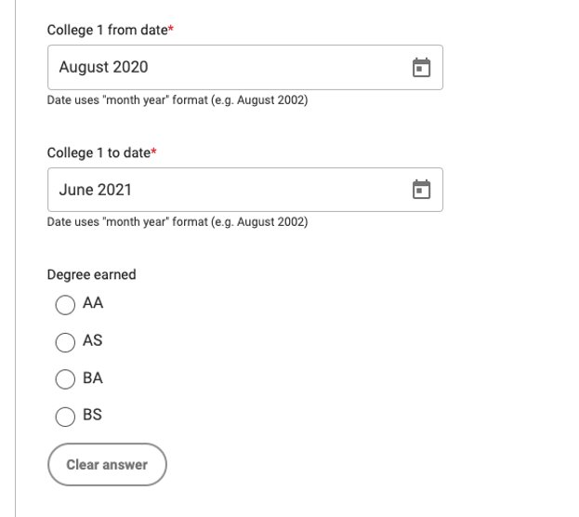
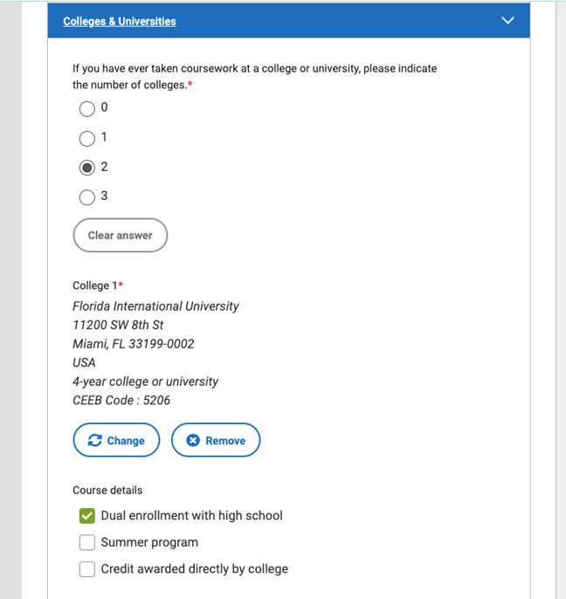
THE COMMON APP
DUAL ENROLLMENT
Notice there is not an asterisk next to “Degree Earned”, so unless you are graduating with your AA, leave this blank.

Slide 32
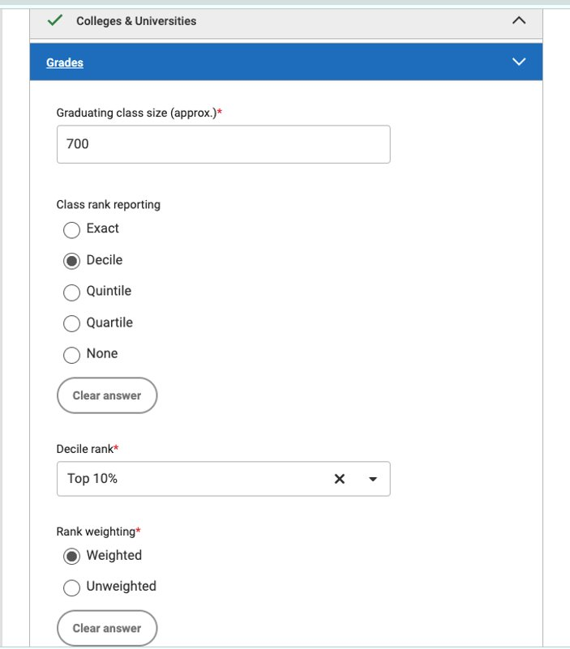
CLASS STATS
CLASS SIZE: 676
CLASS RANK: Gables does not rank students, we only haver percentile ranking, so you’ll select DECILE. Percentages will be announced around the end of September or early October. ​

Slide 33
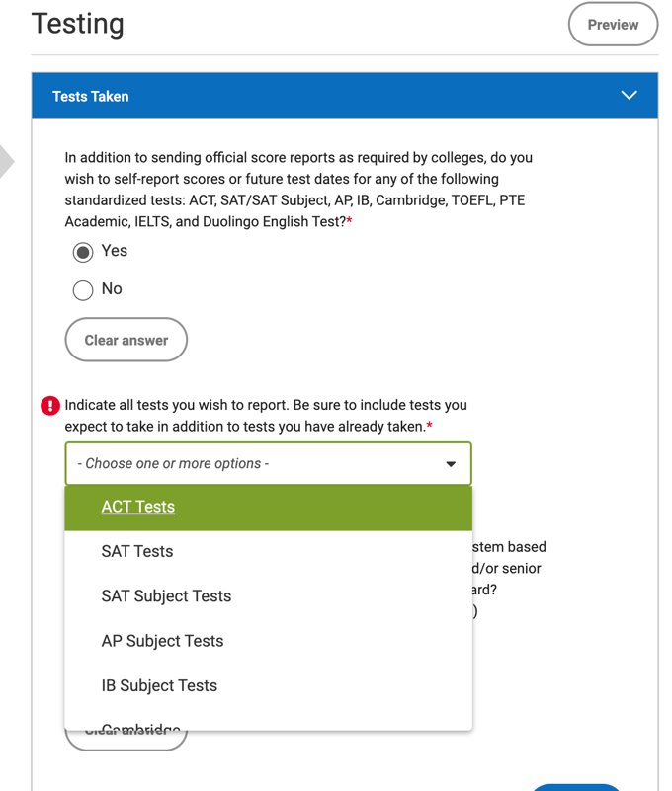
THE COMMON APP
TESTING SECTION:
Some of your schools may be test optional, while others may require them. Before submitting your application, make sure you edit this section if you have different preferences for different schools.

Slide 34
MEET YOUR DEADLINES!
EARLY DECISION:
UM’s Early Decision Deadline: November 1st
EARLY ACTION:
FSU Early Action Deadline: October 15th –TEST SCORE UPDATES BY DEC.1
UM’s Early Action Deadline: November 1st
UF’s Early Action Deadline: November 1st – TEST SCORES BY NOV.15
FIU’s Early Action Deadline: November 1st
REGULAR DECISION:
UF’s Deadline: January 15th
FSU’s Deadline: December 1ST
ROLLING ADMISSION:
FIU application closes: February 25th
UCF application closes: May 1st

Slide 35
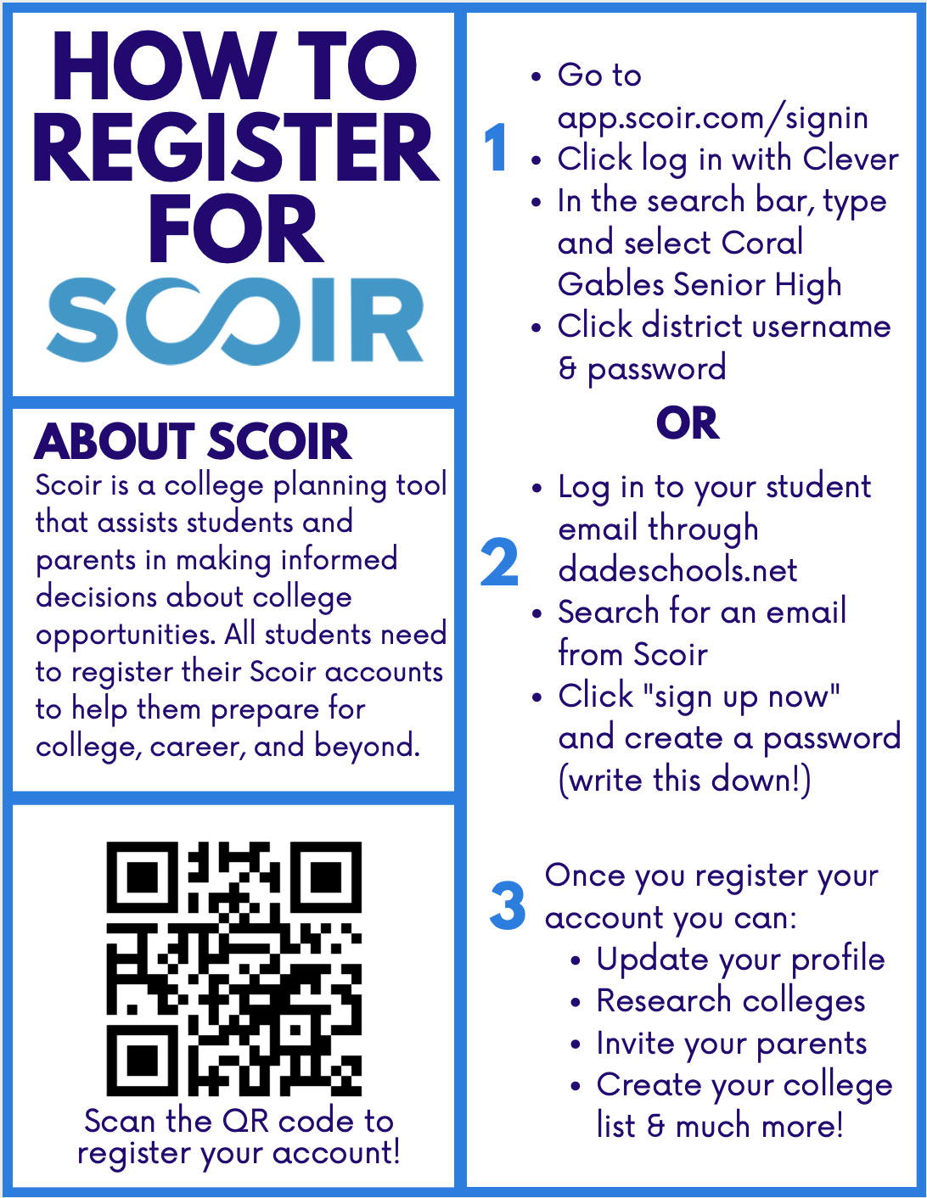

Slide 36
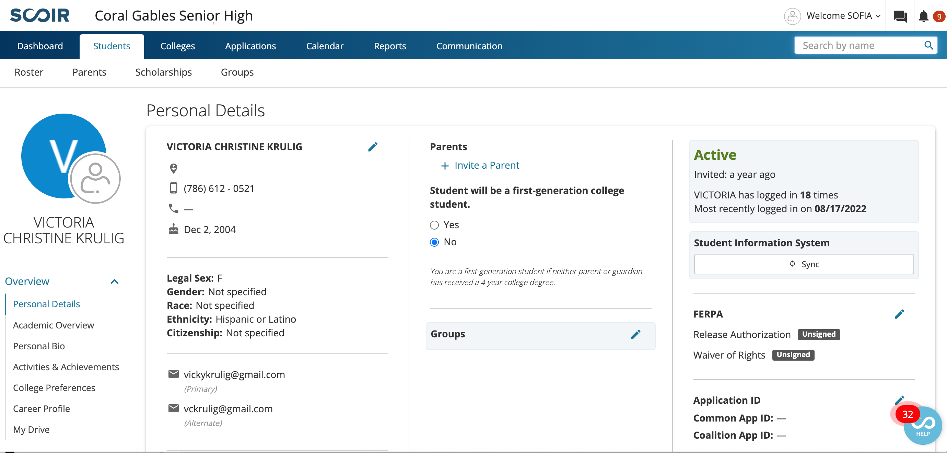
SCOIR
UPDATE YOUR PROFILE
ADD A PHOTO
UPDATE PERSONAL DETAILS, ACTIVITIES,AND COLLEGE PREFERENCES

Slide 37
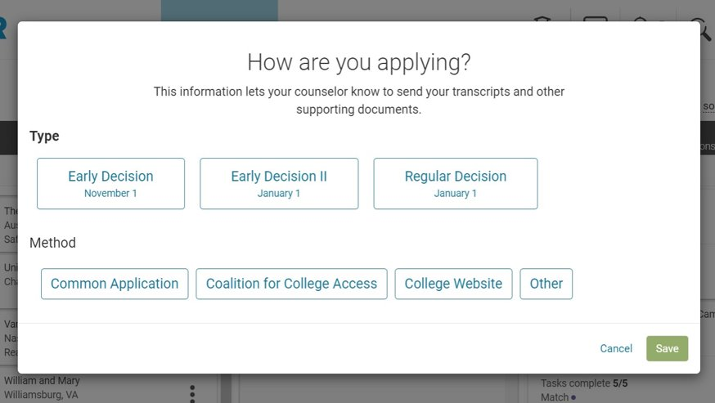
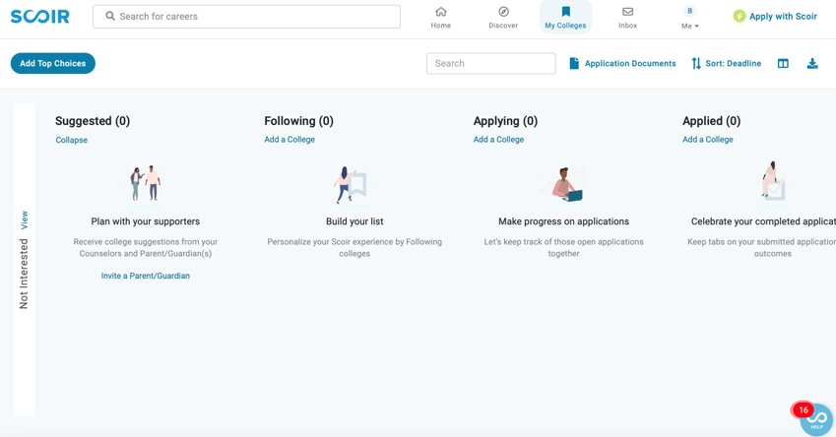
NEXT STEPS
1. UPDATE YOUR “APPLYING” COLUMN ON SCOIR. ADD ALL THE SCHOOLS YOU PLAN TO APPLY TO.

Slide 38
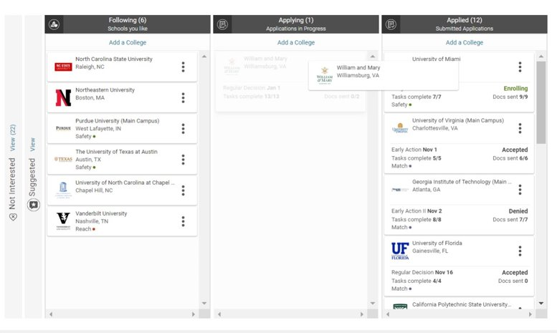
NEXT STEPS
2. MOVE THE COLLEGE FROM THE APPLYING TO APPLIED COLUMN. THIS ACTS AS YOUR NOTICE TO ME TO SEND YOUR DOCUMENTS. NO NEED TO SEE ME/EMAIL ME FOR THIS.

Slide 39
REQUESTING LETTERS OF RECOMMENDATION ON SCOIR
CLICK HERE FOR SCOIR SUPPORT INSTRUCTIONS FOR REQUESTING LETTERS OF RECOMMENDATION

Slide 40
LETTERS OF RECOMMENDATION WITH COMMON APP
CLICK HERE FOR THE STEP BY STEP GUIDE

Slide 41
NEXT STEPS
3. KEEP TRACK OF YOUR APPLICATIONS AND ACTION ITEMS. ​ALWAYS CHECK YOUR EMAIL FOR NEXT STEPS. ​
  Some things you may need to do after applying:​
    Creating an account to see your outcome (myfiu portal, myfsu, cane id, etc.)​
    Submitting Florida residency form​
    Paying the application fee or submitting a fee waiver​
    Financial aid or scholarship applications​
    Submitting additional documents or forms

Slide 42
SCOIR DEADLINES
If applying to a school with a NOVEMBER 1ST DEADLINE OR EARLIER you MUST add that school to your “applying” column before SUNDAY, OCTOBER 6TH
If applying to a school with a deadline AFTER NOVEMBER 1ST you MUST add that school to your “applying” column before SUNDAY, OCTOBER 27TH
You should already be requesting recommendation letters from teachers. Give your recommenders AT LEAST 2 weeks before the application deadline to submit letters. Each recommender may have different preferences, so talk to them now.

Slide 43
TRANSCRIPTS
Transcripts are being updated will be ready for request/upload VIA SCOIR AROUND THE END OF SEPTEMBER OR EARLY OCTOBER
All the fabulousness you all did over the summer is being added on DISTRICT-WIDE…this takes time. Once they are updated, GPAs & rank will be calculated & available.
ORDERING TRANSCRIPTS:
  CommonApp? SCOIR
  Florida school’s online app? SCOIR
  Out of state school or Florida private school not listed on electronic listing found on our website? SCOIR
  UF, FSU, FAU, FGCU, UNF, NEW COLLEGE, & FL POLYTECH: COMPLETE THE SSAR, SELF REPORTED STUDENT ACADEMIC RECORD
    https://ssar.selfreportedtranscript.com/Login.aspx (very easy to Google as well!)

Slide 44
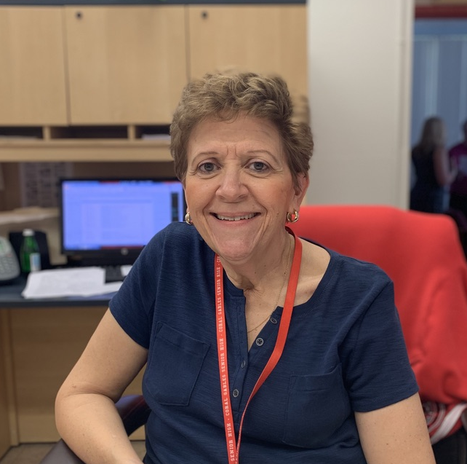
TRANSCRIPTS
Your initial transcripts will be uploaded into SCOIR
Questions about transcripts?
Email Ms. Garcia: solgarcia@dadeschools.net
MS. GARCIA
TRANSCRIPT COORDINATOR
Registration office

Slide 45
FINANCIAL AID
FAFSA: Federal Student Aid
  It should be MUCH smoother this year. They are aiming to open the application on October 1st. Fingers crossed!
FFAA: Florida Student Aid, also known as Bright Futures Application
  Application opens Sunday, October 1st
SCHOLARSHIPS: You need to put in the work to search and apply for scholarships.
  Check CAP Corner and MS Teams for Scholarships posted by the CAP Office

Slide 46
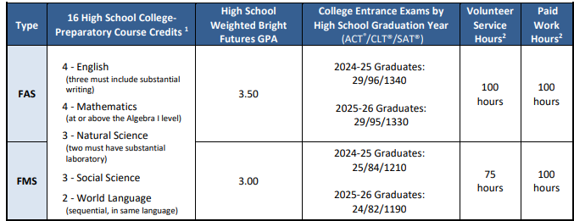
BRIGHT FUTURES

Slide 47
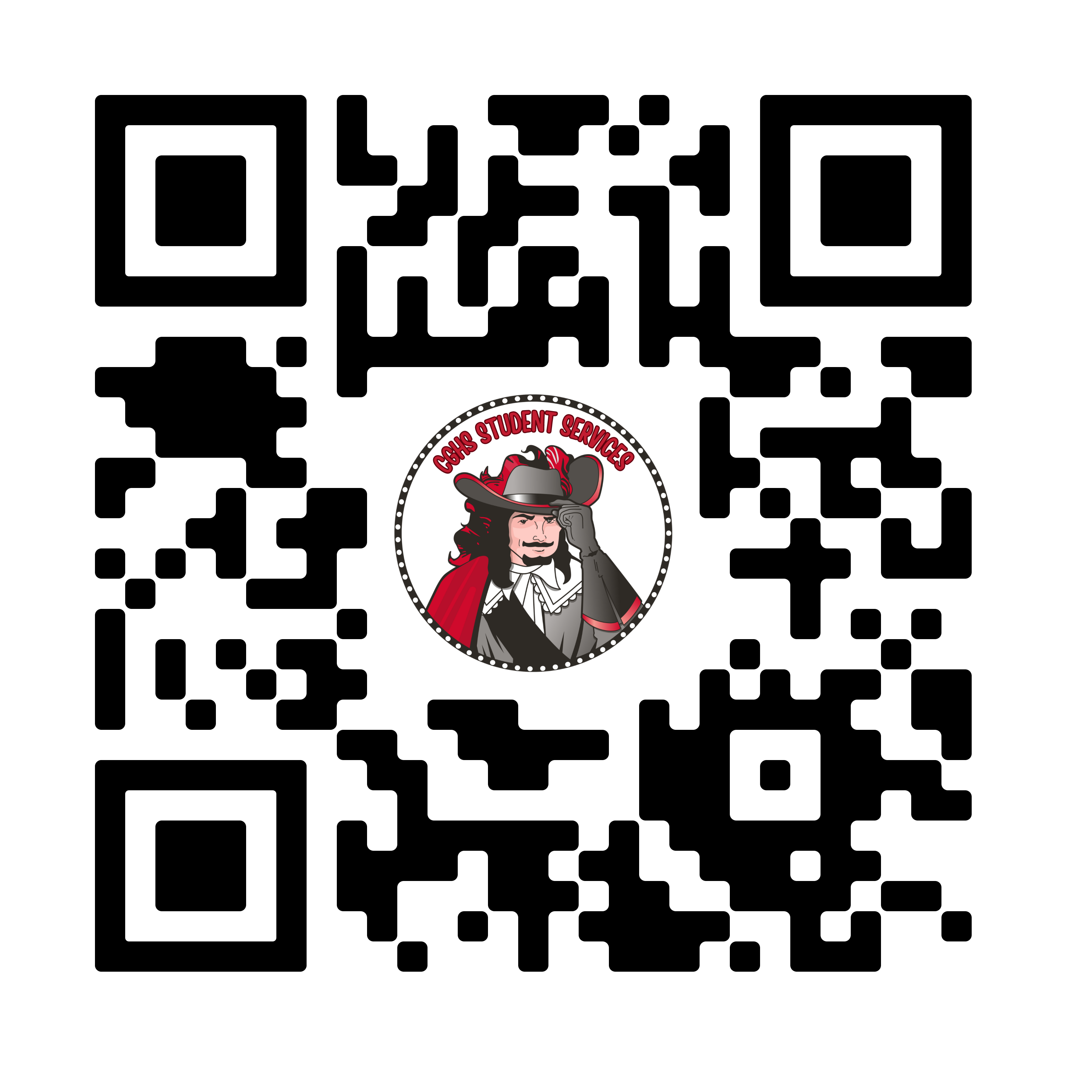
QUESTIONS?
CONTACT ME!
ssanz@dadeschools.net
CAP Office: 6111
Schedule a meeting:

