Slide 2
NEW COUNSELOR ASSIGNMENTS
COUNSELOR | STUDENT LAST NAMES | EMAIL
Academy Students (DEH, HSPSL, BMIT, VPA, CAFDM)
Mr. Sepulveda | A-D | ksepulveda@dadeschools.net
Ms. Collado | E- MARTINEZ, K | 339573@dadeschools.net
Ms. Pedroso | MARTINEZ, L- RI | bpedroso@dadeschools.net
Ms. Bergouignan | RJ-Z | mebergouignan@dadeschools.net
IB Students
Ms. Lezcano | A-K | nlezcano@dadeschools.net
Ms. Kurzner | L-Z | lkurzner@dadeschools.net
AOF Students
Ms. Lezcano | A-GOM | nlezcano@dadeschools.net
Ms. Kurzner | GON- N | lkurzner@dadeschools.net
Ms. Bergouignan | O-Z | mebergouignan@dadeschools.net
College Information
Ms. Sanz | ALL STUDENTS | ssanz@dadeschools.net

Slide 3
GRADUATION REQUIREMENTS
SUBJECT | CREDITS
ENGLISH/LANGUAGE ARTS | 4: ELA 1, 2, 3, 4
MATHEMATICS | 4: *Must include Algebra 1 and Geometry
SCIENCE | 3: *Must include Biology 1 and two of which must have a lab
SOCIAL STUDIES | 3: World History, U.S History, U.S Government, and Economics with Financial Literacy
FINE AND PERFORMING ARTS, SPEECH AND DEBATE, OR PRACTICAL ARTS | 1: Eligible courses are in the Florida Course Code Directory
PHYSICAL EDUCATION | 1: To include the integration of health
ELECTIVES | 8

Slide 4
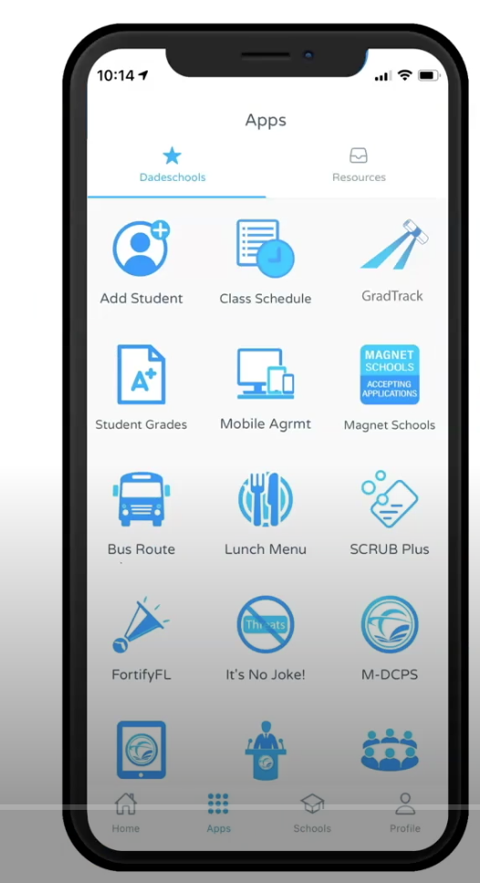
GRAD TRACK

Slide 5
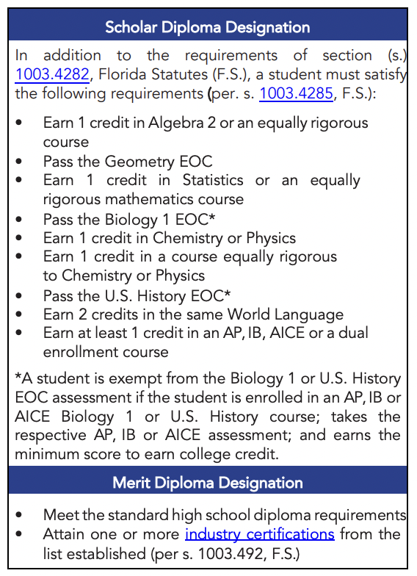

Slide 6
CAP COMMUNICATIONS
Email: ssanz@dadeschools.net
Instagram: @Gables_CAP
MS Teams: Class of 2025
CAVSCONNECT.COM
CAP CORNER- SENIORS

Slide 7
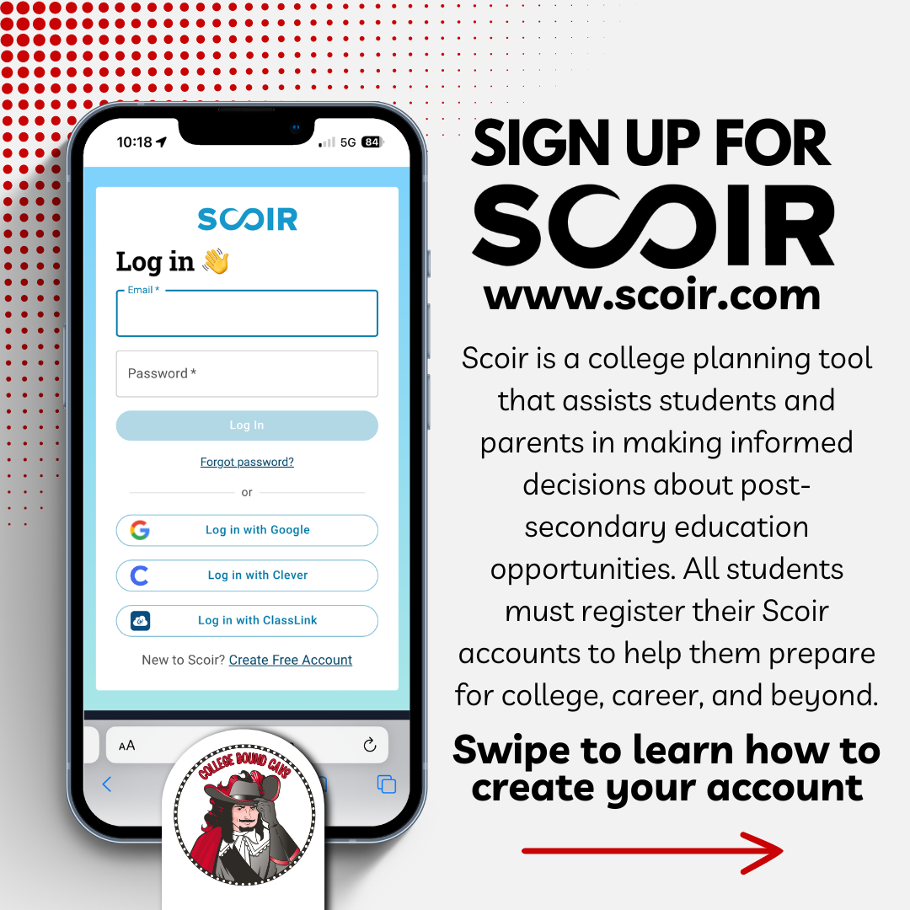
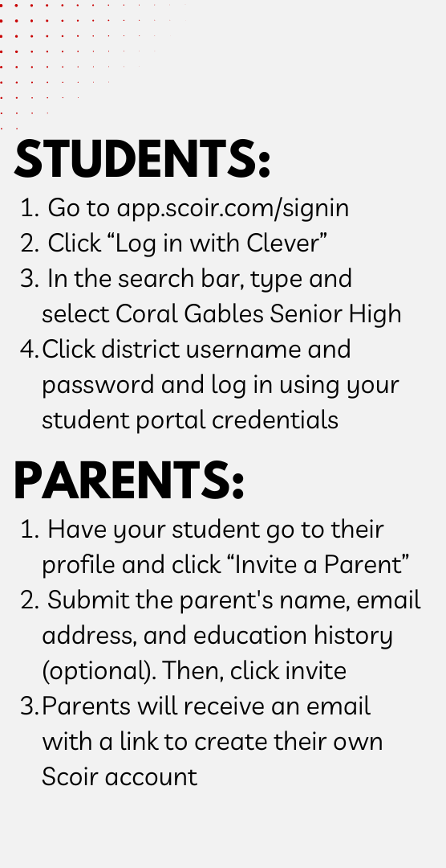

Slide 8
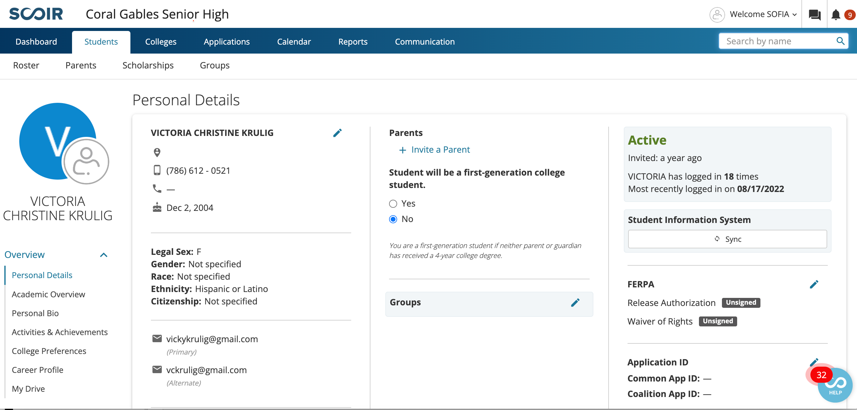
SCOIR
A college planning tool that assists parents and students in making informed decisions about college opportunities. All students must have a registered Scoir account. Only your student can invite you to join.

Slide 9
IMPORTANT DATES
FINANCIAL AID NIGHT:
Tuesday, October 1st at 6:30 pm on Zoom
BRIGHT FUTURES:
Application opens October 1st
FAFSA:
*Application opens October 1st
COLLEGE FAIR:
Monday, October 14th

Slide 10
POST-SECONDARY EDUCATION
COLLEGE OR UNIVERSITY (FIU, Harvard, Pomona College)
COMMUNITY COLLEGE (Miami Dade College, Santa Fe)
VOCATIONAL/TECHNICAL (Robert Morgan, Lindsay Hopkins
MILITARY (Army, Navy, Marines)

Slide 11
COMMUNITY COLLEGES AND STATE UNIVERISTIES
Programs of 6 months to full Bachelor’s degrees
OPEN ADMISSIONS: anyone with a high school diploma or GED is admitted.
Applications are simple, transcript is the only entry requirement.
Vast selection of programs including Graphic Design, Music Production & Management, Fire Science Technology, Nursing and much more.
Programs to consider:
MDC Honors
MDC Pathway Program

Slide 12
PICKING A COLLEGE OR UNIVERSITY
FACTORS TO CONSIDER:
Four-year, two-year, or vocational?
Location: close to home or far away? City life or college town?
Size: Under 3,000 students or over 30,000 students?
Coed or single sex?
Private or public institutions?
What programs are offered?
What sports or extracurricular activities are available?
Cost? Do not exclude any choices because of high cost (Expensive schools often offer more aid) ALWAYS CHECK THE NET PRICE CALCULATOR

Slide 13
THE COLLEGE LIST
AT LEAST 2 REACH SCHOOLS
AT LEAST 4 MATCH SCHOOLS
AT LEAST 2 REAL SAFETY SCHOOLS
RESEARCH THE COLLEGE’S ADMISSION DATA ON SCOIR OR LOOK AT THE COLLEGE’S WEBSITE FOR THE COMMON DATA SET:
most important facts and figures about a college that allows you to easily look up certain pieces of information, helps you compare colleges, and even provides demographic breakdowns of admissions and enrollment statistics

Slide 14
SELECTIVITY OF COLLEGES
OPEN ADMISSIONS: 100% acceptance rate
Community Colleges: application, high school degree- automatic acceptance
SELECTIVE: < 70% acceptance rate
Clemson, UCF, Syracuse, Penn State
VERY SELECTIVE: < 40% acceptance rate
UF, FSU, Villanova, Wake Forest, Smith College
MOST SELECTIVE: < 20% acceptance rate
Ivy League, Duke University, NYU, UChicago, UC Berkeley

Slide 15
WHAT ARE COLLEGES LOOKING AT?
IMPORTANT FACTORS:
Strength of curriculum (IB, AP, Honors)
Grade Point Average (GPA) and class rank (percentile)
College Entrance Examination Scores (ACT or SAT)
Activities student is involved in
IF THE COLLEGE REQUIRES THEM:
Essays
Recommendation Letters (teacher and counselor)
Resume (leadership, community service, extracurricular, talents, etc.)
Interviews

Slide 16
COLLEGE ENTRANCE EXAMS
ACT
ACT scores range from 1 to 36.
English
Math
Science
Reading
SAT
SAT scores range from 400 to 1600.
Reading/Writing
Math
CLT
Only valid for FL public universities
Verbal Reasoning
Quantitative Reasoning
Grammar & Writing
Can be taken at home

Slide 17
UPCOMING EXAM DATES
SAT
ACT
REGISTER AT SAT.SUITE.COLLEGEBOARD.ORG
REGISTER AT MYACT.ORG
REGISTER AT MYACT.ORG
EXAM DATE | REGISTRATION DEADLINE
August 24th | August 9th / 13th
October 5th | September 20th / 24th
November 2nd | October 18th /22nd
December 7th | November 22nd /26th
March 8th | February 21st / 25th
May 3rd | April 18th / 22nd
June 7th | May 22nd / 27th
EXAM DATE | REGISTRATION DEADLINE
September 14th | August 9th / 25th
October 26th | September 20th /7th
December 14th | November 8th / 22nd
February 8th | January 3rd / 20th
*Blue: last exam for UF deadlines
*Garnet: last exam for FSU deadlines

Slide 18
FEE WAIVERS
You must complete this form: incomesurvey.dadeschools.net
If you qualify for free or reduced lunch, you may qualify for testing and application fee waivers.
4 ACT Waivers (4 different codes)
2 SAT Waivers (1 code)
Unlimited Scoir Application Fee Waivers
TO REQUEST AN ACT/SAT FEE WAIVER: see me in room 6111 or send me an email at ssanz@dadeschools.net
Scoir fee waivers can be requested under My Colleges- Application Documents
CLT waivers must be requested by the student on their website

Slide 19
ESSAY RESOURCES
THE COLLEGE ESSAY GUY IS THE BEST RESOURCE FOR WRITING THE PERSONAL STATEMENT
You can create an account and then have access to the on-demand courses or register for one of the other 2 options:
ON DEMAND COURSES https://students.collegeessayguy.com/student-courses-OD
How to Write a Personal Statement
How to Write the College Application + Supplemental Essays
How to Write the UC Personal Insight Questions
LIVE BOOTCAMPS https://www.collegeessayguy.com/sub-ceg-live-students
College App & Supplemental Essays: Sunday, September 22nd from 5-7 pm ET
How to Answer the UC Personal Insight Questions: Saturday October 5th -Sunday October 6th from 5-7pm ET
CHOOSE YOUR OWN ADVENTURE https://www.collegeessayguy.com?msopen=/member/plans/srhofjec1n
Workbook to help you write your personal statement

Slide 20
APPLYING FOR ADMISSION
APPLICATION: required everywhere
TRANSCRIPT OR SSAR
APPLICATION FEE: (fee waiver(s) can be used, see me for more info.)
SAT/ACT SCORES: required or test optional
LETTERS OF RECOMMENDATION: (if applicable)
ESSAY/PERSONAL STATEMENT: (if applicable…share your voice!)
COPY OF OTHER REQUIRED DOCUMENTATION: (if applicable)

Slide 21
TYPES OF APPLICATIONS
EARLY DECISION: binding, regardless of financial aid status. You can only apply to only one ED school and must sign a contract, along with your parents & myself. Please bring a copy of the Net Price Calculator.
EARLY ACTION: nonbinding. Students can apply to multiple schools as EA. Apply early (October-November) and receive notice by December.
REGULAR DECISION: varies per college/university. most deadlines are around January and decisions are made by mid-March-April.​
ROLLING ADMISSION: accepts students as applications come in, and until they run out of spots, so apply early!​

Slide 22
THE TIMELINE
Private Scholarship Season
College Scholarship Deadlines
Admissions Decisions from Universities
Early Action/Early Decision/Priority Applications Due
SAT/ACT Testing
Regular Decision Applications Due
Decision Day
August September October November December January February March April May
FFAA (Bright Futures) Application Opens
Financial Aid Packages
Housing Applications
FAFSA Opens

Slide 23
WHERE TO START
Sign up for the SAT/ACT if you still need to do so.
Finish researching colleges and make your list/excel spreadsheet. Organize it by deadline!
Mark those schools as applying on Scoir.
Involve family and look at the cost of attendance to these schools.
Go to the Undergraduate Admissions websites of each of your colleges. Create an account on their application site or Common App.
SAVE THE USERNAMES AND PASSWORDS IN A SAFE PLACE!

Slide 24
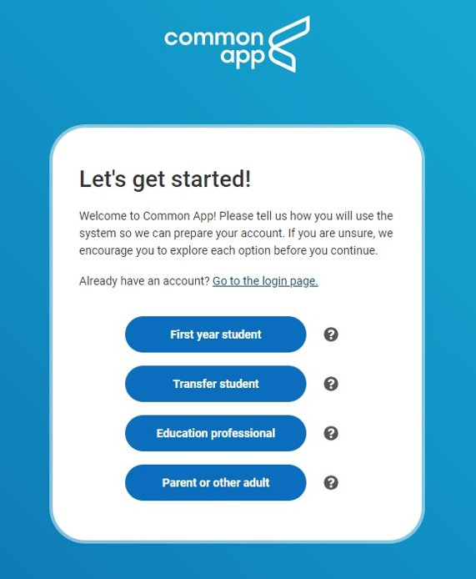
WHERE TO APPLY
INSTITUTIONAL APPLICATION: college admissions application provided by the specific school (or group of schools) that you are applying to. You can find this on the school’s admissions website.
COMMON APPLICATION: one of the most popular college admission applications. Appy to multiple schools using one application. ​
Create an account at commonapp.org

Slide 25
MEET YOUR DEADLINES!
EARLY DECISION:
UM’s Early Decision Deadline: November 1st
EARLY ACTION:
FSU Early Action Deadline: October 15th –TEST SCORE UPDATES BY DEC.1
UM’s Early Action Deadline: November 1st
UF’s Early Action Deadline: November 1st – TEST SCORES BY NOV.15
FIU’s Early Action Deadline: November 1st
REGULAR DECISION:
UF’s Deadline: January 15th
FSU’s Deadline: December 1ST
ROLLING ADMISSION:
FIU application closes: February 25th
UCF application closes: May 1st

Slide 26
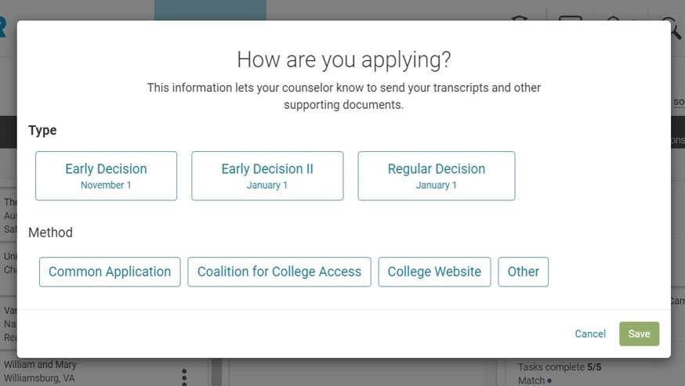
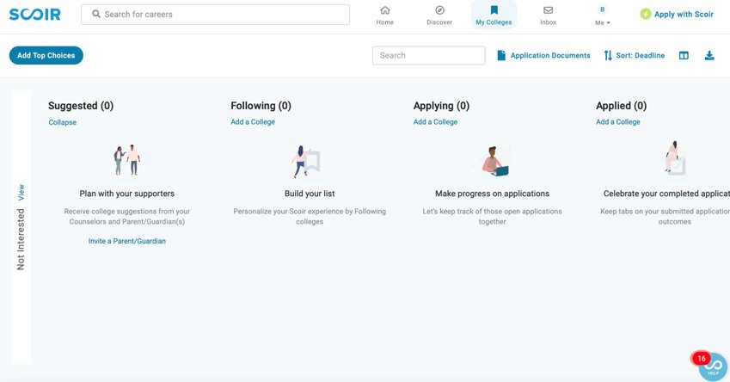
NEXT STEPS
UPDATE YOUR “APPLYING” COLUMN ON SCOIR. ADD ALL THE SCHOOLS YOU PLAN TO APPLY TO.

Slide 27
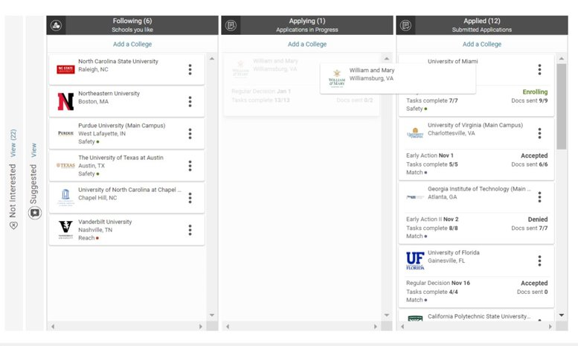
NEXT STEPS
MOVE THE COLLEGE FROM THE APPLYING TO APPLIED COLUMN. THIS ACTS AS YOUR NOTICE TO ME TO SEND YOUR DOCUMENTS. NO NEED TO SEE ME/EMAIL ME FOR THIS.

Slide 28
NEXT STEPS
KEEP TRACK OF YOUR APPLICATIONS AND ACTION ITEMS. ​ALWAYS CHECK YOUR EMAIL FOR NEXT STEPS. ​
Some things you may need to do after applying:​
Creating an account to see your outcome (myfiu portal, myfsu, cane id, etc.)​
Submitting Florida residency form​
Paying the application fee or submitting a fee waiver​
Financial aid or scholarship applications​
Submitting additional documents or forms

Slide 29
FINANCIAL AID
FAFSA: Federal Student Aid
Federal Aid application. Opens October 1st. Uses 2023 income tax information.
CSS: College Financial Aid application. Mostly used for private or out of state schools.
FFAA: Florida Student Aid, also known as Bright Futures Application
Application opens October 1st
SCHOLARSHIPS: Students need to put in the work to search and apply for scholarships.
Check MS Teams and Cavs Connect CAP Corned for Scholarships posted by the CAP Office

Slide 30
SCHOLARSHIPS
THREE MAIN TYPES OF SCHOLARSHIPS
INSTITUTIONAL: Usually are the most generous. Students can qualify by applying early and meeting the school’s requirements for their merit based scholarships. Each school has different requirements, check the scholarship page on their website.
Most cases, you are automatically considered for all of their scholarships, but sometimes there are additional requirements, such as:
Earlier deadlines
Additional essays
Nomination forms
Letters of recommendation

Slide 31
SCHOLARSHIPS
THREE MAIN TYPES OF SCHOLARSHIPS
PRIVATE: Can be very competitive and take a lot of work, but are often the deciding factor against student loans or can fill the financial need gap left over ater financial aid letters are awarded.
Can be awarded as many as possible (depending on the school)
Some take financial need into consideration, some do not
Have various application platforms and different requirements (essay, recommendation letters, service projects, etc)

Slide 32
BRIGHT FUTURES
Application opens October 1st
Should apply even if they don’t meet the requirements yet
Deadline: June 30th

Slide 33
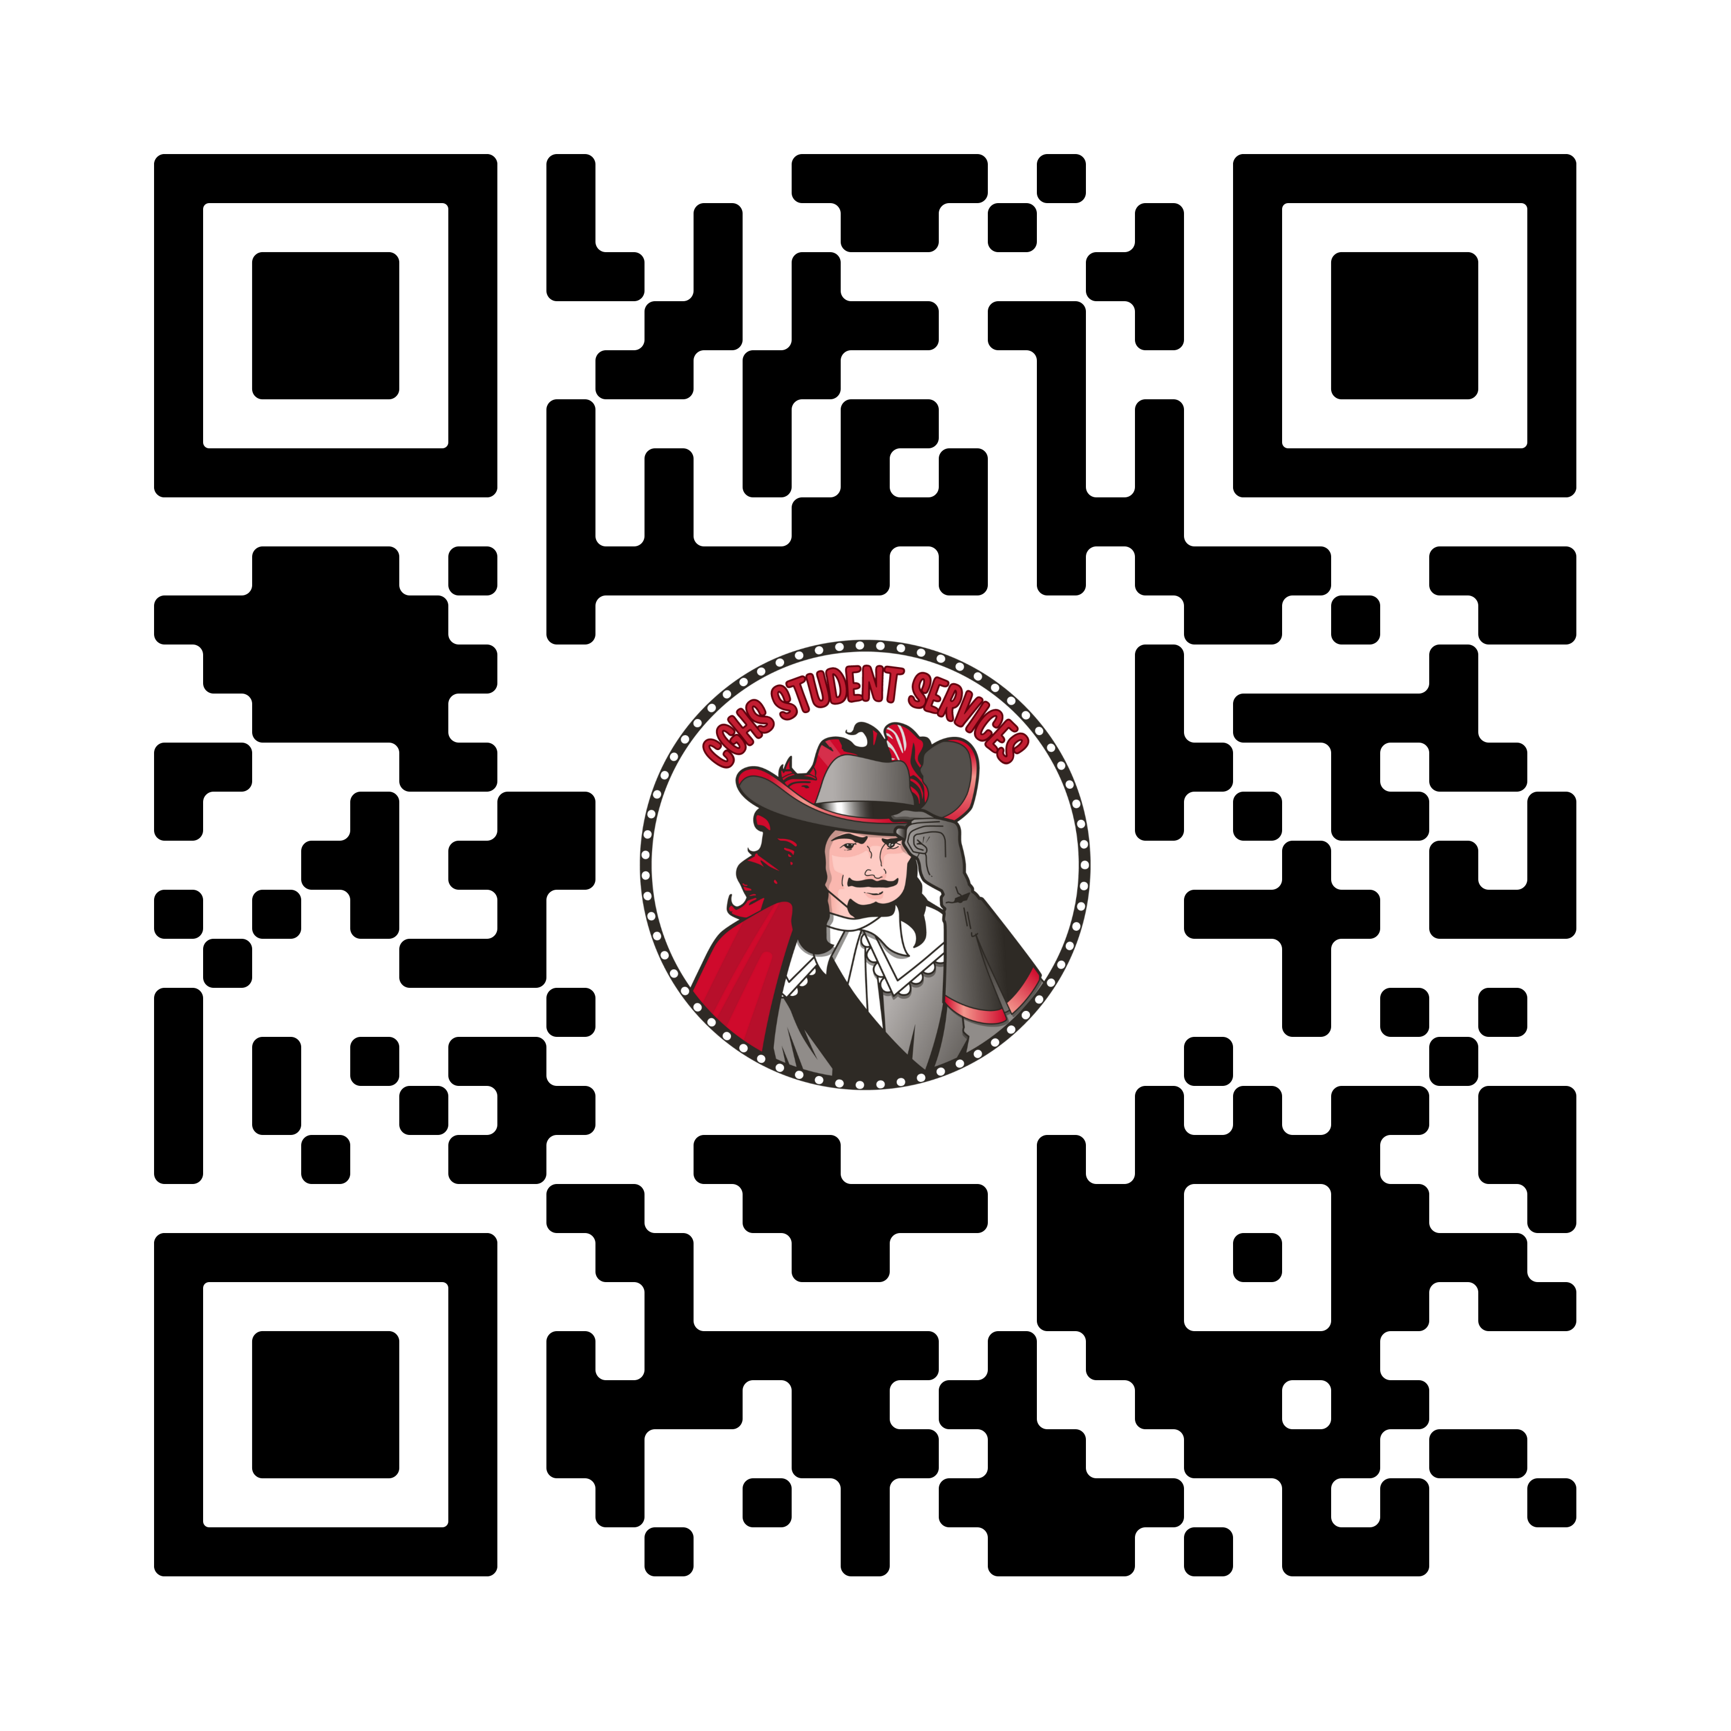
QUESTIONS?
CONTACT ME!
Q & A Google Doc
ssanz@dadeschools.net
CAP Office: 6111
Schedule a meeting:

